Slide 1
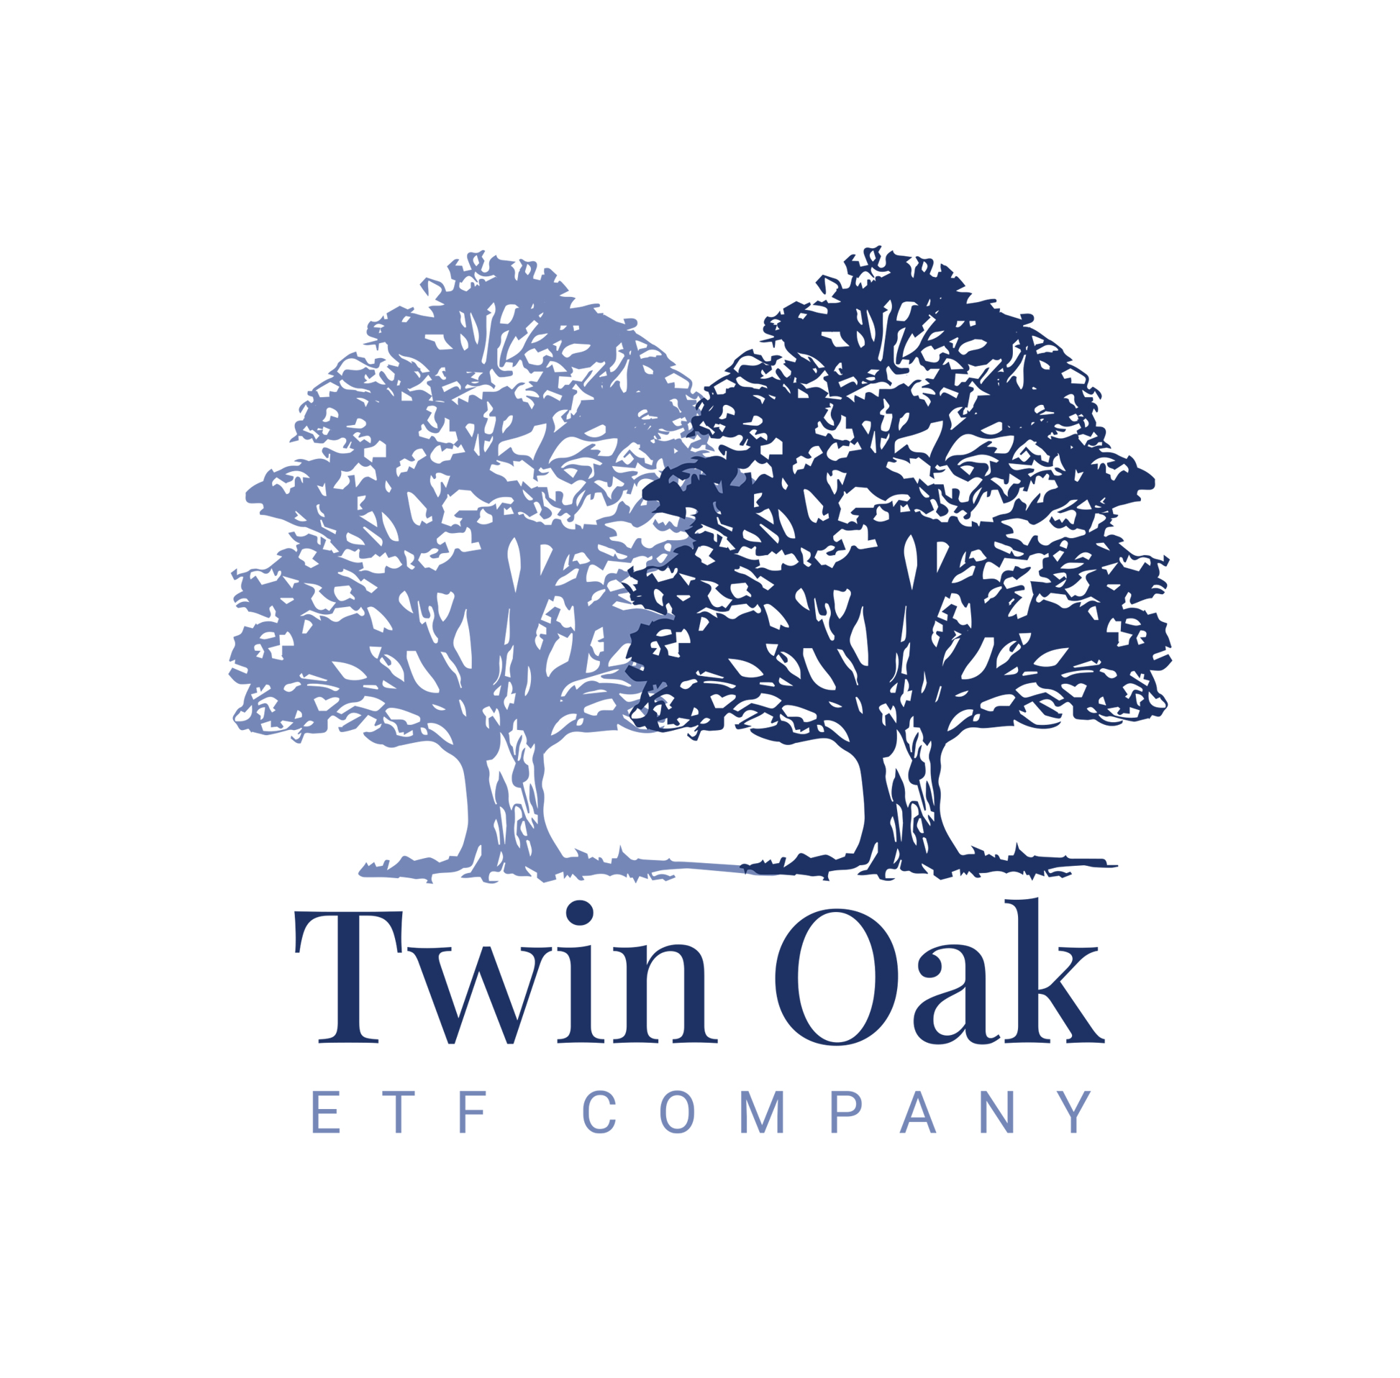
Confidential | For Institutional Use Only
A Next Generation Active ETF Company
Family Office Club Audit
zach@twinoak.com
greg@twinoak.com
August 2024

Slide 2
Confidential | For Institutional Use Only
Disclaimer
The contents of this document are confidential and proprietary, are furnished exclusively for the use of the person to whom it is provided directly by Twin Oak ETF Company, and may not be copied, disclosed, distributed or used in any way by the person to whom it was provided or by any other party without the express prior written permission of Twin Oak ETF Company (herein, “Twin Oak”). Nothing herein constitutes or should be construed as an offering of securities or a recommendation to purchase or sell securities. Such an offering may be made only to qualified offerees, only at the time such an offeree receives a confidential private offering memorandum or disclosure statement (“CPOM”), a subscription agreement, or other offering documents (collectively referred to as “Other Offering Documents”), which will contain important information (including investment objective, policies, risk factors, fees, tax implications and relevant qualifications), and only in those jurisdictions where permitted by law. In the case of any inconsistency between the contents of this document and the contents of Other Offering Documents, the Other Offering Documents shall control. Any reliance on information or disclosures not contained in, or inconsistent with, information in the Other Offering Documents shall be solely at the recipient’s own risk.
The information contained herein is in summary form and is for informational and discussion purposes only. Twin Oak makes no representations or warranties as to the accuracy, timeliness or completeness of the information set forth herein. Information that is currently accurate may become inaccurate at a subsequent date, and Twin Oak does not undertake to update or correct such information. Certain information contained in this document constitutes “forward-looking statements,” which can be identified by the use of forward-looking terminology such as “may,” “will,” “should,” “expect,” “anticipate,” “project,” “estimate,” “intend,” “continue,” or “believe,” or the negatives thereof or other variations thereon or comparable terminology. Any projections, market outlooks or estimates in this document are forward-looking statements and are based upon certain assumptions. These assumptions may prove to be wrong in hindsight. Other events which were not taken into account may occur and certain risks may materialize, which significantly affect the returns or performance of Twin Oak and the clients it advises. Due to such risks and uncertainties, actual events, results or the actual performance of investments by Twin Oak or clients it advises may differ materially from those reflected or contemplated in such forward-looking statements. Nothing contained herein may be relied upon as a guarantee, promise, assurance or a representation as to the future. Certain information included in this document represents the observations and subjective views of Twin Oak. Industry participants may reasonably disagree with these observations and views. Predictions, opinions and other information contained herein are subject to change continually and without notice of any kind. The information contained herein should only be read in conjunction with, and is subject in all respects to, the notes set forth throughout this document in the footers. There is no guarantee that the investment objective of Twin Oak or clients it advises will be achieved. Past performance is not a guarantee of, and is not necessarily indicative of, future results. As with any investment, an investment in a strategy advised by Twin Oak includes a potential for profit as well as the possibility of loss. Nothing herein is intended as tax, legal, or investment advice. Prospective investors are strongly urged to review the Other Offering Documents carefully and consult with their counsel and advisers before investing.

Slide 3
Confidential | For Institutional Use Only
EXECUTIVE SUMMARY
Reimagine the Fund Manager / Investor relationship through the use of ETF investment vehicles.
Platform to attract institutional-grade portfolio managers in a retail accessible vehicle
BETTER SOPHISTICATION
ETFs are available in a brokerage account, not via complex SMA or private fund vehicle
ETFs tend to be more tax efficient than other fund vehicles because they generate fewer capital gain distributions^{1,2}
BETTER ACCESS
TAX EFFICIENCY (BETTER COST)
Refer to Endnotes for additional information.

Slide 4
Confidential | For Institutional Use Only
HOW WE WIN
Building a firm that democratizes access to institutional grade investment strategies.
Cultivate Investment Strategies
Build ETF Platform
Drive Distribution
Leverage internal experience and external networks to develop innovative investment strategies
Quickly launch and scale ETFs in partnership with family offices, RIAs, and fund managers
Broaden the ecosystem’s access to our strategies by removing friction for allocators

Slide 5
Confidential | For Institutional Use Only
FOUNDATIONAL PILLARS
We provide products and services to clients that adhere to several foundational pillars.
Tax-aware
Simplicity
Focus on delivering after-tax returns utilizing modern investment vehicles, like ETFs, that are generally more tax efficient than legacy structures.^{1,2}
Designing simple, elegant solutions for complex portfolio exposures enables us to deliver lower cost solutions for clients.
Creativity
Stewardship
Navigate complexity to unlock the ETF industry’s untapped potential to bring innovative solutions into client portfolios in partnership with allocators and fund managers.
The best interest of our investors is at the forefront of all decisions. We are stewards of our clients' assets first; trust is the cornerstone of a partnership that spans generations.
Tax-aware
Simplicity
Creativity
Stewardship

Slide 6
Company Vision

Slide 7
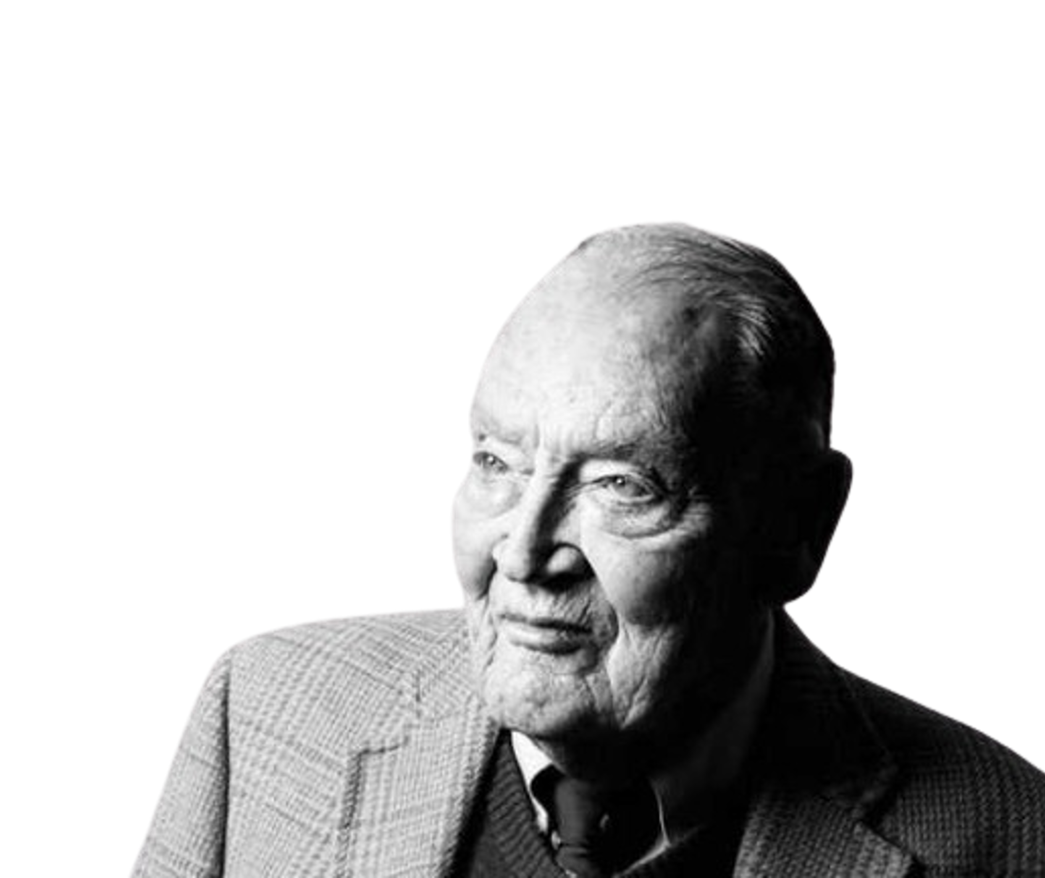
Confidential | For Institutional Use Only
“Managed funds are astonishingly tax-inefficient.”
Jack Bogle, Founder of The Vanguard Group
Tax-aware
Simplicity
Creativity
Stewardship

Slide 8
Confidential | For Institutional Use Only
OUR VISION
We believe ETFs are a superior investment vehicle compared to legacy structures.
Optimal Alignment
Better Liquidity & Access
Fewer Realizable Tax Events
ETFs can better align an investors experience with their own investment decisions; reducing the impact of other investors on their investment returns
SEC Rule 6c11 lowered the hurdle to launch active ETFs, allowing us to democratize access to institutional strategies in ETF form³
ETFs have intra-day liquidity and pricing
ETFs tend to distribute fewer capital gains^{1,2}
ETFs tend to be lower cost than comparable funds^{4,5}
Reduced tax drag and lower fees generally leads to better net returns
Tax-aware
Simplicity
Creativity
Stewardship
Refer to Endnotes for additional information.

Slide 9
Confidential | For Institutional Use Only
OUR VISION
Our opportunity lies at intersection of quality + cost to disrupt the current financial services ecosystem.
Can offer multi asset class strategies with persistence of alpha
Not liquid for LPs / Investors
HEDGE FUNDS
SMAs
FACTOR EXPOSURE
Offer incremental transparency and liquidity
Low tax efficiency and lacks long-term alpha⁶
ACTIVELY MANAGED MUTUAL FUNDS
ACTIVELY MANAGED ETFs
PASSIVELY MANAGED ETFS
Offer liquidity and tax efficiency^{1,2,5}
Beta driven return profile
Tax-aware
Simplicity
Creativity
Stewardship
Refer to Endnotes for additional information.

Slide 10
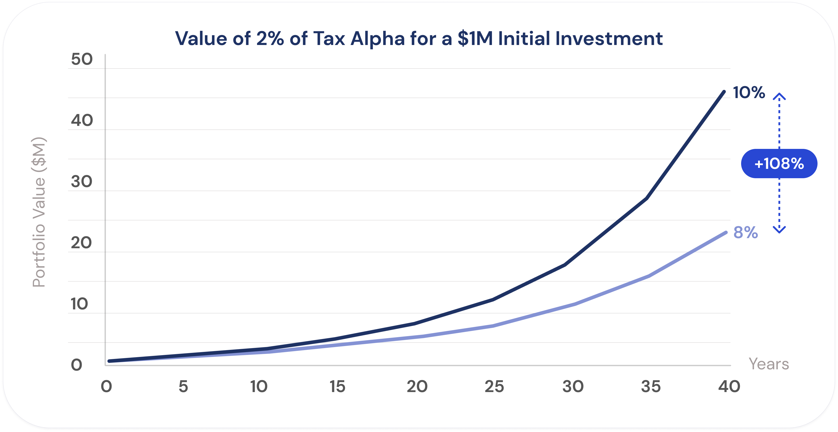
Confidential | For Institutional Use Only
OUR VISION
At the end of the day, we’re passionate about higher quality products that seek to provide the optimal net returns to clients.
Tax-aware
Simplicity
Creativity
Stewardship
*All information is strictly illustrative and solely for educational purposes and expresses the observations and subjective views of Twin Oak. There is no offer of securities being made. All prospective clients should consult their own legal, investment, and tax advisors to determine suitability of the investment. Refer to Endnotes for additional information.

Slide 11
The Opportunity

Slide 12
Confidential | For Institutional Use Only
THE OPPORTUNITY: FAMILY OFFICES
We believe the ETF wrapper is underutilized in most asset allocations.
EXISTING FAMILY OFFICE ASSET ALLOCATION*
EXISTING PUBLIC EQUITY PORTFOLIO COMPOSITION
IDEAL PUBLIC EQUITY PORTFOLIO COMPOSITION
Public Equity 38%
ETFs 27%
ETFs 85%
Direct Stock 30%
Tax friction and legacy asset allocation decisions prevent family offices from achieving optimal portfolios.
If given more tax considerate, bespoke strategies, Twin Oak believes clients would weight their portfolio’s heavily towards ETFs.
Twin Oak’s ETFs and in-kind seeding of ETFs can help reduce the friction and portfolio inertia.
Private Equity 21%
Twin Oak can enable this transition in a tax-efficient manner
Real Assets 16%
Hedge Funds 25%
Fixed Income 15%
Single Stock
18%
Hedge Funds 5%
Cash & Other 11%
Single Stock 10%
Tax-aware
Simplicity
Creativity
Stewardship
*All information is strictly illustrative and solely for educational purposes and expresses the observations and subjective views of Twin Oak. There is no offer of securities being made. All prospective clients should consult their own legal, investment, and tax advisors to determine suitability of the investment.

Slide 13
Confidential | For Institutional Use Only
THE OPPORTUNITY: REGISTERED INVESTMENT ADVISORS
EXISTING RIA ASSET ALLOCATION (MODERATE) PORTFOLIO ALLOCATION
EXISTING RIA EQUITY PORTFOLIO COMPOSITION
OPTIMAL ETF PORTFOLIO COMPOSITION
We believe the ETF Wrapper is underutilized in most asset allocations.
Cash 5%
Cash ETFs 5%
International Markets 15%
Fixed Income 35%
Fixed Income
ETFs 35%
Small Cap Blend 10%
If given more tax considerate, bespoke strategies, Twin Oak believes clients would weight their portfolio’s heavily towards ETFs.
Twin Oak’s ETFs and in-kind seeding of ETFs can help reduce the friction and portfolio inertia.
Mid Cap Blend 15%
Twin Oak can enable this transition in a tax-efficient manner
Equity 60%
Equity ETFs 60%
Large Cap Blend
20%
Tax-aware
Simplicity
Creativity
Stewardship
*All information is strictly illustrative and solely for educational purposes and expresses the observations and subjective views of Twin Oak. There is no offer of securities being made. All prospective clients should consult their own legal, investment, and tax advisors to determine suitability of the investment.

Slide 14
Our Solution

Slide 15
Confidential | For Institutional Use Only
OUR SOLUTION: FAMILY OFFICES
Twin Oak partners with families to launch bespoke ETF solutions; these strategies can be seeded with cash or “in-kind.”
Services can be provided as a comprehensive package or “à la carte”
Seeding
Custom ETF Launch
Fund Launch Partner*
Investment Management
Cash or in-kind seeding capabilities
Project management
Coordination of vendors
Strategy identification
Portfolio management
ETF launch platform
Investment advisor or sub-advisory services
ETF sponsor and on-going management
Reporting
*Every custom ETF or Launch partnership seeks to balance investor preference with Twin Oak fiduciary responsibilities
Developed in partnership with client
Active security selection
Active asset allocation
Twin Oak implemented portfolios
Tax-aware
Simplicity
Creativity
Stewardship

Slide 16
Confidential | For Institutional Use Only
OUR SOLUTION: FAMILY OFFICES
In many instances, families can benefit from a bespoke ETF seed to develop a diversified portfolio of actively managed exposures.
NO CHANGE
High tax-efficiency
Low cost
Lower go-forward return potential
ETF CONVERSION
Active or passive management
Higher go-forward return potential
Tax efficient
Additional fees
REALIZE & REINVEST
Active Management
Higher go-forward return potential
Tax inefficient
Tax-aware
Simplicity
Creativity
Stewardship
*All information is strictly illustrative and solely for educational purposes and expresses the observations and subjective views of Twin Oak. There is no offer of securities being made. All prospective clients should consult their own legal, investment, and tax advisors to determine suitability of the investment.

Slide 17
Confidential | For Institutional Use Only
OUR SOLUTION: REGISTERED INVESTMENT ADVISORS
Twin Oaks provides convenience services to help RIAs transition client portfolios to realize the benefits of exchange traded funds.
Services can be provided as a comprehensive package or “a la carte”
Conversion
Custom ETF Launch
Fund Launch Partner*
Investment Management
Strategy Identification
Vendor management
Manage seeding transaction
Strategy Identification
Vendor management
Manage seeding transaction
Sub-advisory services
Trading services management
Reporting
*Every custom ETF or Launch partnership seeks to balance investor preference with Twin Oak fiduciary responsibilities
Sub-advise
Active security selection
Active asset allocation
Tax-aware
Simplicity
Creativity
Stewardship

Slide 18
Confidential | For Institutional Use Only
OUR SOLUTION: REGISTERED INVESTMENT ADVISORS
In many instances, RIAs can benefit from converting highly appreciated equity portfolios into an exchange traded fund.
NO CHANGE
High tax-efficiency
Low cost
Lower go-forward return potential
ETF CONVERSION
Active or passive management
Higher go-forward return potential
Tax efficient
Additional fees
REALIZE & REINVEST
Active Management
Higher go-forward return potential
Tax inefficient
Tax-aware
Simplicity
Creativity
Stewardship
*All information is strictly illustrative and solely for educational purposes and expresses the observations and subjective views of Twin Oak. There is no offer of securities being made. All prospective clients should consult their own legal, investment, and tax advisors to determine suitability of the investment.

Slide 19
Confidential | For Institutional Use Only
OUR SOLUTION: CONVERSIONS
Conversion Timeline & Activities. Twin Oak works collaboratively throughout and manages this process.
Appreciated Securities Converted into ETF (100-180 days)
Product Development
Define Investment Strategy
Engage service providers
Review potential securities for seeding transaction
Legal Review
Engage legal & tax advisors
Receive tax opinion for seeding transaction
ETF Registration (75+ days)
Draft ETF Prospectus and file with the SEC
The SEC has a 75-day minimum waiting period
Amend Prospectus as needed
ETF Launch
After ETF is declared effective by the SEC, the initial in-kind contribution of appreciated securities can occur
After in-kind transaction has settled, the ETF can be listed on an exchange for trading
Tax-aware
Simplicity
Creativity
Stewardship
*Launch timeline information is for illustrative purposes only. Twin Oak does not guarantee the timeline of any ETF launch process.

Slide 20
Confidential | For Institutional Use Only
OUR SOLUTION: CUSTOMIZABLE FOR POST LAUNCH EFFICIENCY
ETF Investors maintain control of their individual shares in the ETF which can be voted through the proxy voting process and bought, sold, or margined.*
After launch, Twin Oak maintains day-to-day management as the Advisor of the ETF.
Post-launch
Buy/Sell via Brokerage Account
Investors
ETF Shares
ETF Operations
Security Selection
Trade Management
Tax-aware
Simplicity
Creativity
Stewardship
*Whether or not a security can be margined is subject to the terms and agreements established with a client’s brokerage service. Twin Oak does not guarantee an ETF share’s ability to be margined.

Slide 21
Confidential | For Institutional Use Only
OUR SOLUTION: ILLUSTRATIVE STRATEGIES
We seek to provide institutional grade and tax efficient ETF strategies in low cost offerings.
Short Duration Absolute Return
Tail Risk Hedged Market Beta
Target duration less than one year
Broad based market exposure with drawdown mitigation
Intermediate Duration Fixed Income
Balanced Fund
FIXED INCOME ALTERNATIVES
Target duration between five and ten years
OPPORTUNISTIC EXPOSURES
Dynamically allocating between equity and fixed income
Long Duration Fixed Income
Environmental Impact
Target duration over ten years
Liquid access to climate-related investments
Multi Strategy Fixed Income
Commodities
Derivative enhanced fixed-income
Innovative exposure to commodities
Treasury Curve
Equities
Capture persistent dislocations along the treasury curve
Concentrated stock portfolios
Tax-aware
Simplicity
Creativity
Stewardship

Slide 22
Twin Oak
Advantage

Slide 23
Confidential | For Institutional Use Only
TWIN OAK ADVANTAGE – STRUCTURAL
Our ETFs seek to combine the best of all major investment structures.
Traditional ETFs
Mutual Funds
Hedge Funds
Alpha Opportunities
Unique Beta Exposures
Number of Funds
2⁹
3,108¹⁰
7,393¹¹
3,872¹²
Tax Efficient
Low Cost
Tax-aware
Simplicity
Creativity
Stewardship
Refer to Endnotes for additional information.

Slide 24
Confidential | For Institutional Use Only
TWIN OAK ADVANTAGE – ADVISORY TEAM & ACCESS TO INVESTMENT TALENT
Our team consists of experienced investors with cross asset class, institutional, and tax aware expertise.¹³
HEDGE FUND EXPERIENCE
BUSINESS LEADERS
Senior Advisor
Hedge fund manager featured in The Big Short
Advisor
Former family office CEO who ran two
multi-billion single family offices
Specialty: Multi-Asset Derivatives
Investing Experience: 25+ Years
Specialty: Public & Private Taxable Investments
Investing Experience: 20+ Years
Senior Advisor
Hedge fund manager and public company board member
Advisor
Former institutional investment manager
Specialty: Multi-Asset Derivatives
Investing Experience: 25+ Years
Specialty: Portfolio Management & FinTech
Investing Experience: 15+ Years
Advisor
Multi-strategy hedge fund manager
Compliance Advisor
Former hedge fund manager legal counsel
and SEC Branch Chief
Specialty: Multi-Asset Derivatives
Investing Experience: 25+ Years
Specialty: Regulatory Compliance
Investing Experience: 25+ Years
Tax-aware
Simplicity
Creativity
Stewardship
Refer to Endnotes for additional information.

Slide 25
Confidential | For Institutional Use Only
TWIN OAK ADVANTAGE: LEADERSHIP
Unique combination of institutional and tax aware expertise along with significant operational scaling expertise.
Chief Executive Officer
Managing Director
Senior Advisor
Private Single Family Office
Scion Asset Management
Zach Wainwright
Greg Stoner
John Downing
12 years of public and private investing on behalf of taxable & non-taxable clients.
6 years investment experience, prior 9 years organizing complex precision aviation operations.
26+ years investment experience culminating in portfolio construction and management of several prominent ETFs
Tax-aware
Simplicity
Creativity
Stewardship

Slide 26
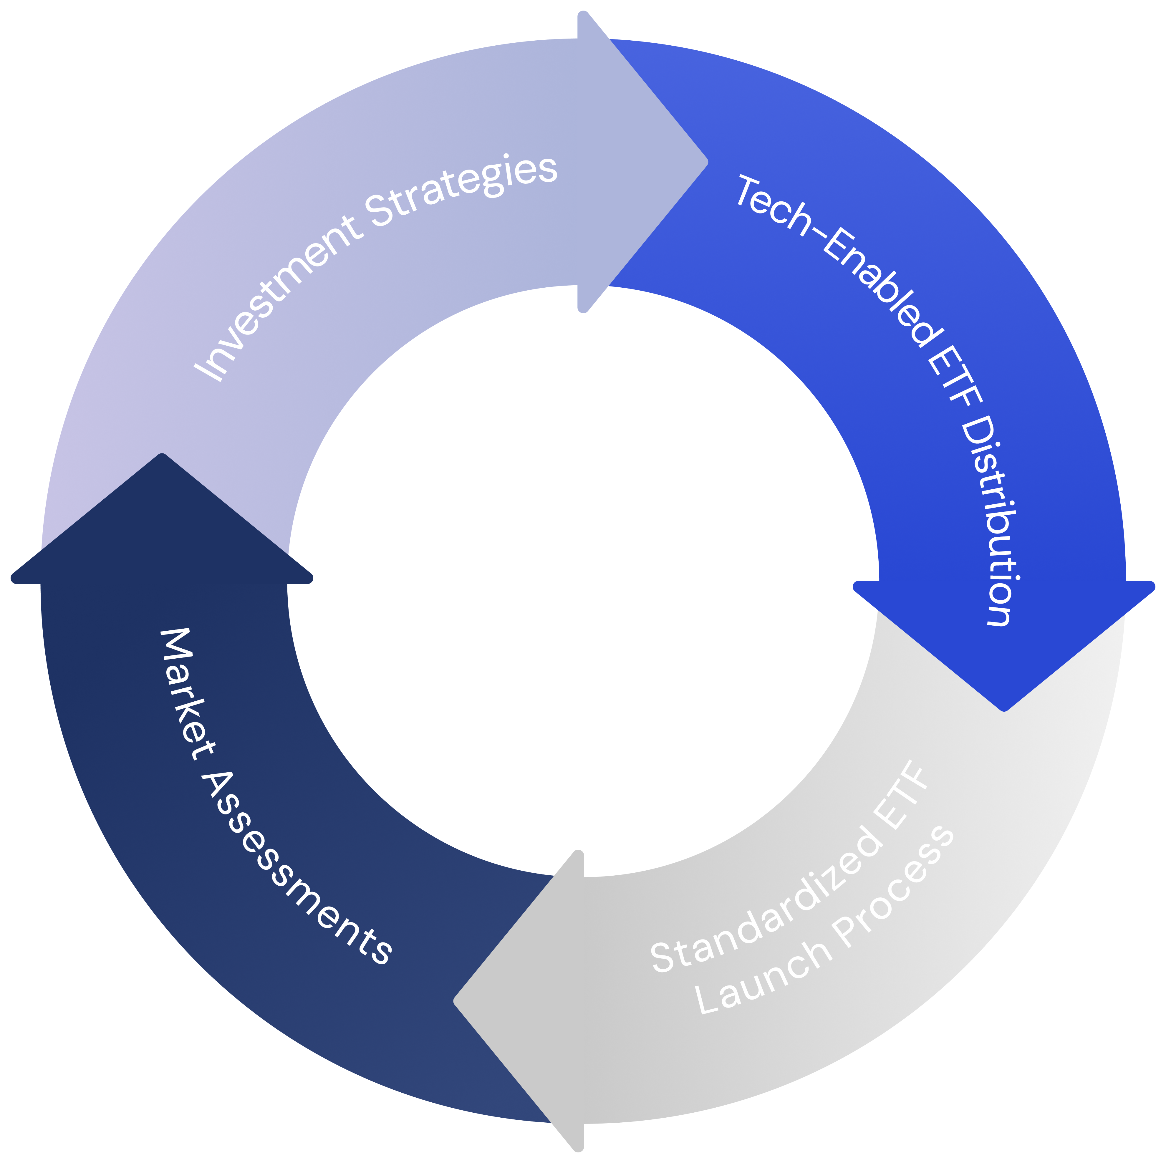
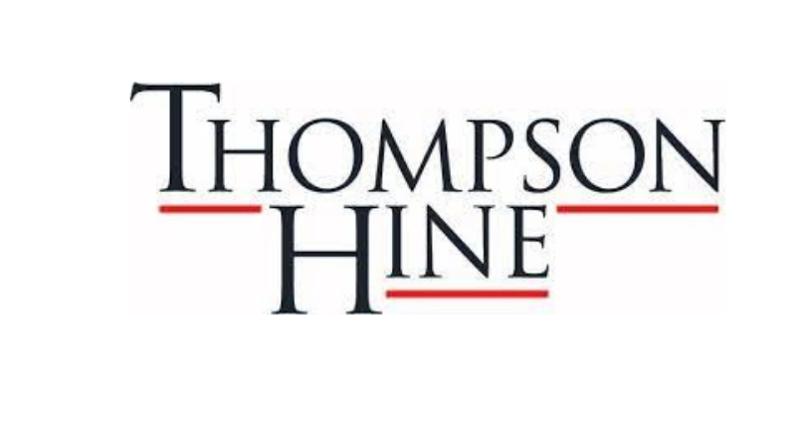
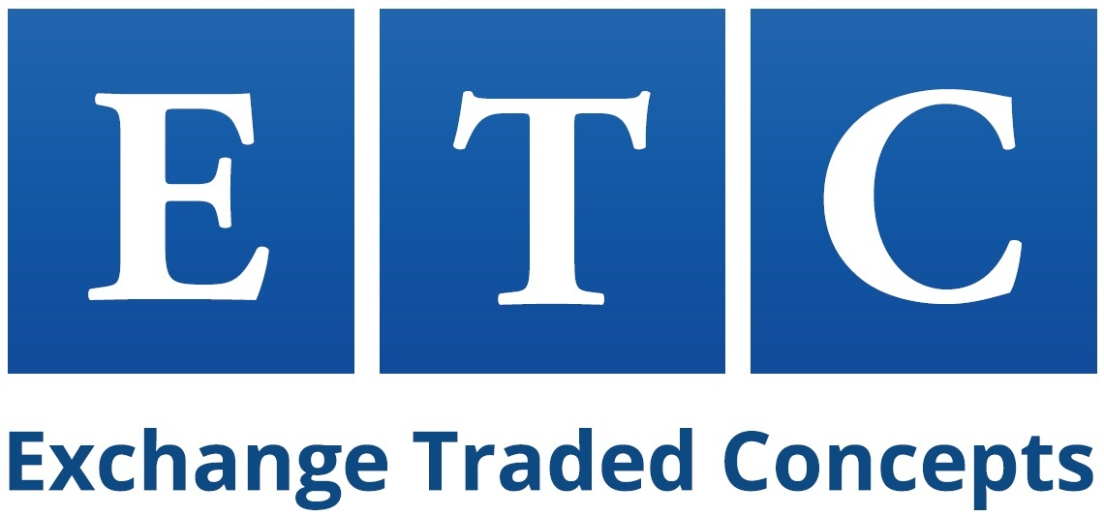
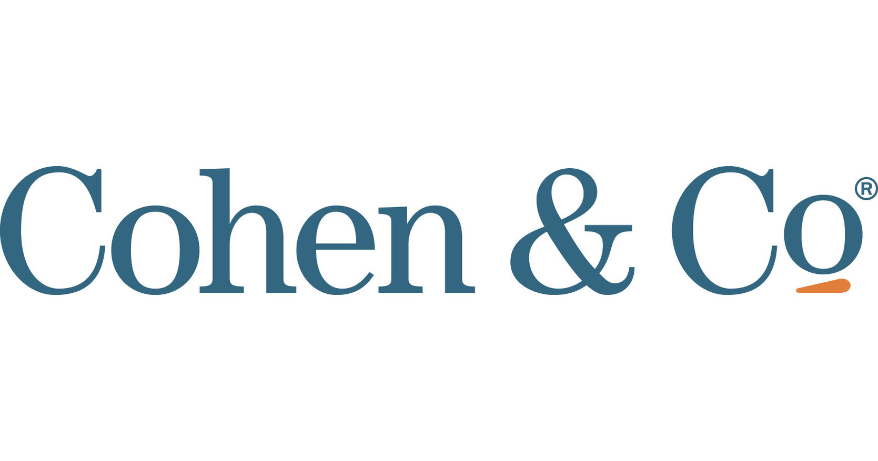
Confidential | For Institutional Use Only
TWIN OAK ADVANTAGE: SCALABILITY
With economies of scale, Twin Oak can pass through cost savings to clients.
Internally developed strategies supported by advisors
Platform for externally developed strategies
Outsourced CTO
Marketing Campaigns
Automated content creation
Economies of Scale
Regulatory Compliance Consultant
Tax and Accounting
FIRM OPERATIONS
Legal
Legal
Legal
Outsourced Trading
Data driven assessments
Repeatable process
Differentiation Analysis
ETF Trust, Custody, Administration
Common infrastructure
Streamlined Framework
ETF SERVICE PROVIDERS¹⁴
Fund Tax and Audit
ETF Compliance and Distribution
Fund Legal
Tax-aware
Simplicity
Creativity
Stewardship
Refer to Endnotes for additional information.

Slide 27
Thank you!
Family Office Club Audit
zach@twinoak.com
greg@twinoak.com
August 2024

Slide 28
Endnotes and Additional Information
¹ Source: SEC. December 2016. “Mutual Funds and ETFs: A Guide for Investors”;
² Source: Fidelity. Accessed June 2024. “ETFs vs. mutual funds: Tax efficiency”;
³ The SEC updated Rule 6c11 in 2019, which helped open up the market to active ETF offerings;
⁴ Source: Investment Company Institute. March 2023. “Trends in the Expenses and Fees of Funds, 2022”;
⁵ Source: Fidelity. Accessed June 2024. “ETFs vs. mutual funds: Cost comparison”;
⁶ Source: S&P Global. May 2024. “US Persistence Scorecard Year-End 2023” ;
⁷ Source: Reuters. October 2023. “Asset managers boost ETF assets via active launches, conversions”;
⁸ Source: Statista. June 2023. Total Net AUM of active and passive mutual funds in the US 2000-2022;
⁹ Twin Oak filed 2 prospectuses with the SEC for new ETF launches as of May 31, 2024. Please visit the SEC’s database for updates on their filing status.;
¹⁰ Source: Investment Company Institute. May 2024. ETF Market Size as of December 2023;
¹¹ Source: Statista. September 2023. “Number of mutual funds in the United States from 1997 to 2022”;
¹² Source: IBISWorld. May 2024. “Hedge Funds in the US – Number of Businesses”;
¹³ Advisors serve as advisors to the business, in a personal capacity, and are not involved in any portfolio management efforts;
¹⁴ ETF service providers are subject to approval by the ETF trust and are subject to change. Refer to SEC filings for up-to-date information.
Definitions (as used by Twin Oak):
Institutional Grade – Investment strategies generally only accessible in private fund formats to accredited investors.
Tax Alpha – The amount of a gross return lost to the tax drag of an investment vehicle through realized taxable events.
Low Cost – Low cost is defined on a case-by-case basis, but generally refers to solutions that are cheaper than private funds (2% management fees and 20% carry).

